Slide 1
1516
Programming Fundamentals with Python
Week 10: Exceptions, Filesystem, Operating System

Slide 2
Learning Outcomes
Exception Handling
try/except/finally
multiple handlers
Raising Exceptions
Filesystem – os module

Slide 3
Exception Handling
We have been coding too optimistically
E.g. assuming that open(“data.txt”) will always succeed is not a good assumption
Whenever there is a good chance of errors occurring, wrap code in try/except blocks
The code we try to do is put into the try block
If there is an error (an “exception”), control will jump to the try’s associated except block instead
The except block can deal with error handling

Slide 4
TypeError vs. ValueError
x = int(“56”) is ok
x = int("hello") this is a ValueError; the value “hello” cannot be converted to an int
print("hello" + 123) this is a TypeError; the + sign joins int-to-int or str-to-str only

Slide 5
Exception: Example
Consider the following code:
weight_kg = int(input("Enter weight in kg: "))
weight_lbs = float(weight_kg) / 0.454
print("Weight in pounds is %f" % weight_lbs)
What happens if I type in “one hundred” as the input?
Traceback (most recent call last):
File "C:/Users/PycharmProjects/comp1516_lab8/sample.py", line 22, in <module>
weight_kg = int(input("Enter weight in kg: "))
ValueError: invalid literal for int() with base 10: 'one hundred'

Slide 6
Exception Handling
A program should handle exceptions “gracefully”; they should attempt to continue running rather than printing an error message and/or stopping completely
Code that may produce an exception is placed in a try block
If code in the try block causes an exception, the code placed in a following except block is executed
The try and except constructs blocks are implementing “exception handling” – handling exceptional conditions during program execution

Slide 7
Exception Handling: Example
Consider the following code:
try:
weight_kg = int(input("Enter weight in kg: "))
weight_lbs = float(weight_kg) / 0.454
print("Weight in pounds is %f" % weight_lbs)
except:
print("Error: Could not calculate the weight in pounds")
What happens if I type in “one hundred” as the input?
Error: Could not calculate the weight in pounds
The program did NOT crash. It keeps running.

Slide 8
Exception Handling: Basics
try:
# … Normal code that might produce exceptions
except: # Go here is any exception occurs in the try block
# … Exception handling code
When a try block is reached, the statements in the try block are executed
If no exception occurs:
the try continues, and
the except block is skipped, and
the program continues
If an exception occurs:
the rest of the try is skipped, and
the except block is executed, and
the program continues after the except block

Slide 9
Multiple Exception Handlers
try:
# … Normal code
except exceptiontype1:
# Code to handle exceptiontype1
except exceptiontype2:
# Code to handle exceptiontype2
except:
# Code to handle other exception types
Used when a try block may generate different types of exceptions and you want to handle them differently
Analogy:
try:
go camping
bonfire
fishing
swimming
except carError:
go to mechanic
except injuryError:
go to hospital
except lostError:
use map
except:
call your parents

Slide 10
Exception Handling: Multiple Handlers
# we should expect a high chance of errors when dealing with user input
user_input = None
while user_input != 'q':
try:
weight_pounds = int(input("Enter weight (in pounds): "))
height_inches = int(input("Enter height (in inches): "))
bmi = (float(weight_pounds) / float(height_inches * height_inches)) * 703
print('BMI:', bmi)
print('(CDC: 18.6-24.9 normal)\n') # Source www.cdc.gov
except ValueError:
print('Could not calculate health info.\n')
except ZeroDivisionError:
print('Invalid height entered. Must be > 0 inches.')
user_input = input("Enter any key ('q' to quit): ")
QUESTION: What if someone enters negative sixty inches as their height???

Slide 11
Exception Handling: Multiple Handlers
try:
# ...
except(ValueError, TypeError):
# Exception handler for any ValueError or TypeError that occurs.
except(NameError, AttributeError):
# A different handler for NameError and AttributeError exceptions.
except:
# A different handler for any other exception type.
Multiple exception types can be mapped to the same exception handler (as in the above example)
Exactly ONE of the four blocks will be executed in the above example

Slide 12
Exception Handling: Cleanup
try:
# … Normal code
except:
# … Handle exception
finally:
# always executed; e.g. clean-up actions:
The finally clause allows the programmer to specify clean up actions that are always executed.
The finally clause is always the last code executed before the try/except blocks finish.
If no exception occurs, then after the try block finishes, execution continues in the finally clause, and then proceeds with the rest of the program.
If a handled exception occurs, then an exception handler executes and then the finally clause.
If an unhandled exception occurs, then the finally clause executes and then the exception is re-raised.
The finally clause still executes if any break, continue, or return statement causes the try block to be exited. It is useful for performing actions such as closing resources (e.g. files), backing up data, logging data, etc….

Slide 13
Exception Handling: Cleanup Example
nums = [] my_file = input('Enter file name: ') rd_nums = None try: print('Opening', my_file) rd_nums = open(my_file, 'r') # Might cause IOError for line in rd_nums: nums.append(int(line)) # Might cause ValueError except IOError: print('Could not find', my_file) except ValueError: print('Could not read number from', my_file) finally: print('Try Closing the File', my_file) if rd_nums is not None: print("Closing the File") rd_nums.close() print('Numbers found:', ' '.join([str(n) for n in nums]))

Slide 14
Raising Exceptions Ourselves
try:
weight_kg = int(input("Enter your weight in kg: "))
if weight_kg > 1000:
raise ValueError("Weight is too big!")
weight_lbs = float(weight_kg) / 0.454
print("Weight in pounds is %f" % weight_lbs)
Except ValueError:
print("Error: Could not calculate the weight in pounds")
Code that detects an error can execute a raise statement that generates an exception
This immediately exits the try block and executes any exception handlers
https://docs.python.org/3/library/exceptions.html
Later, we can also create our OWN error types (exception types).

Slide 15
Raising Exceptions
try:
weight_kg = int(input("Enter weight in kg: "))
if weight_kg > 1000:
raise ValueError("Weight is too big!")
weight_lbs = float(weight_kg) / 0.454
print("Weight in pounds is %f" % weight_lbs)
except ValueError as v:
print(str(v))
Can display the message associated with the ValueError exception using the “except ValueError as v” notation
The contents of the ValueError are placed in a variable called “v” (in this case)

Slide 16
Exceptions with Functions
The power of exceptions is more clear when used within functions.
If an exception is raised in a function and not handled within that function, the function immediately exits and the calling function is checked for an exception handler (and so on up the function chain)
If no exception handler is found, the program immediately stops and the exception is displayed (e.g., runtime error)

Slide 17
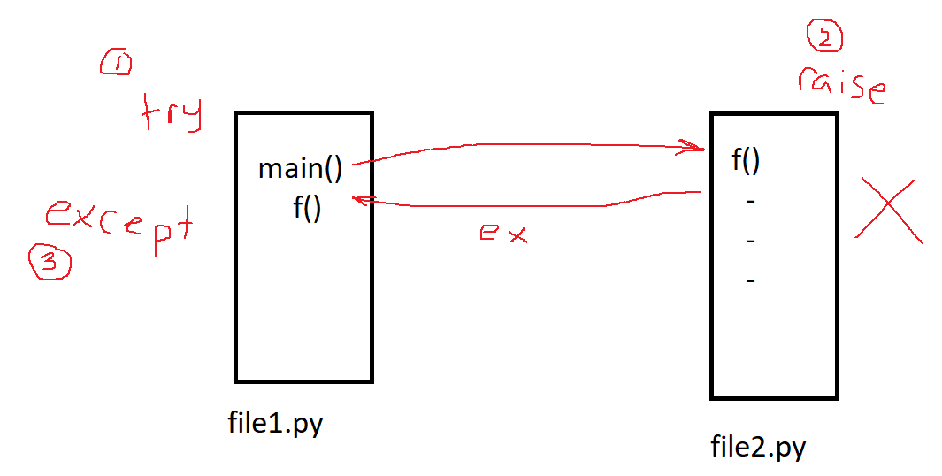
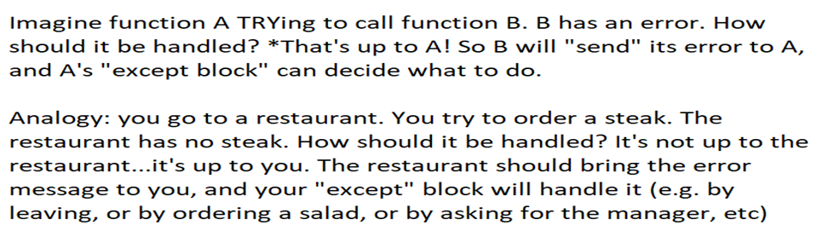
Exceptions with Functions

Slide 18
Exceptions with docstring: Example
def get_weight_pounds():
"""
:raises ValueError: if non-integer input is given or a negative weight is entered
"""
weight_pounds = int(input('Enter weight (pounds): '))
if weight_pounds < 0:
raise ValueError('Invalid weight.')
return weight_pounds
def get_height_inches():
"""
:raises ValueError: if non-integer input is given or a negative height is entered
"""
height_inches = int(input('Enter height (inches): '))
if height_inches <= 0:
raise ValueError('Invalid height.')
return height_inches
try:
weight_lb = get_weight_pounds()
height_in = get_height_inches()
bmi = (float(weight_lb) / float(height_in * height_in)) * 703
print('BMI:', bmi)
print('(CDC: 18.6-24.9 normal)\n')
except ValueError as excpt:
print(excpt)
print('Could not calculate health info.\n')
All ValueError exceptions that happen in the try block, even in called functions, are handled in one place.

Slide 19
Example
import os
def get_list_of_data_from_file(filename):
"""
:param filename: the name of the file to read
:return: a list of the data from the file
:raises: FileNotFoundError if file is not found
:raises: IOError if file has no data in it
:raises: ValueError if filename has "admin" in it
"""
if "admin" in filename:
raise ValueError("admin is not allowed in filename")
if not os.path.isfile(filename):
raise FileNotFoundError("no such file: " + filename)
if os.stat(filename).st_size < 1:
raise IOError("empty file: " + filename)
file = open(filename)
data = file.readlines()
file.close()
return data
try:
print(get_list_of_data_from_file("stuff_admin.txt"))
except FileNotFoundError as e:
print("no such file")
except IOError as e:
print("empty file")
except ValueError as e:
print("no admin allowed")
finally:
print("closing the file, backing up the data, and logging activities")

Slide 20
Better than raising errors
def get_user_weight_lb():
"""
get user's weight in pounds from keyboard, and return it
:return: the user's weight, in pounds
"""
weight_lb = 0
valid_input = False
while valid_input is False:
weight_lb = input("How much do you weigh (pounds)?") # expecting a numeric string
if weight_lb.isnumeric() and 0 < float(weight_lb) <= 1400:
valid_input = True
return weight_lb
print(get_user_weight_lb())

Slide 21
Interacting with the Filesystem
The os module allows you to interact with the filesystem on any operating system (e.g. Windows, MacOS, Linux)
Using the os module enables portability of your Python code across multiple operating systems
To use the os module you need to import it into your code (i.e., import os)

Slide 22
Portability and Filepaths
Filepath representations are different on different operating systems
Windows: subdir\\mobile.jpg
Mac: subdir/mobile.jpg
The character between directories is the file separator. Avoid hard-coding the separator, which would reduce the program’s portability
Instead, use os.path.join() to create a portable file path string:
os.path.join(‘subdir’, ‘mobile.jpg’)
Note that os.path.sep stores the file separator for the current operating system
Tells python to figure it out

Slide 23
Other OS Functions
os.path.split(path) – Splits a path into a 2-tuple (head, tail), where tail is the last token in the path string and head is everything else
os.path.exists(path) – Returns True if path exists, else returns False.
os.path.isfile(path) – Returns True if path is an existing file, and false otherwise (e.g., path is a directory).
os.path.getsize(path) – Returns the size in bytes of path.
os.walk() - 'walks' a directory tree like the one above, visiting each subdirectory in the specified path. The example on the next slide walks a user-specified path of the above directory tree.

Slide 24
OS Functions: os.walk()
The os.walk() function is used as the iterable object in a for loop that yields a 3-tuple for each iteration.
The first item dirname contains the path to the current directory.
The second item subdirs is a list of all the subdirectories of the current directory.
The third item files is a list of all the (non-directory) files in the current directory.
Example:
for dirname, subdirs, files in os.walk(path):
print(dirname, 'contains subdirectories:', subdirs, end=' ')
print('and the files:', files)

Slide 25
OS Functions: os.walk()
Example:
for dirname, subdirs, files in os.walk(path):
print(dirname, 'contains subdirectories:', subdirs, end=' ')
print('and the files:', files)
Example Output:
logs\2009 contains subdirectories: ['April', 'January'] and the files: []
logs\2009\April contains subdirectories: ['1'] and the files: []
logs\2009\April\1 contains subdirectories: [] and the files: ['log.txt', 'words.doc']
logs\2009\January contains subdirectories: ['15', '21', '24'] and the files: []
logs\2009\January\15 contains subdirectories: [] and the files: ['log.txt']
logs\2009\January\21 contains subdirectories: [] and the files: ['log.txt', 'temp23.pdf']
logs\2009\January\24 contains subdirectories: [] and the files: ['presentation.ppt']

Slide 26
Commandline Arguments
import sys
def main(): # sys.argv is a list of string arguments to the PROGRAM
print("main")
print("your age is " + str(get_age_in_years()))
print(sys.argv)
print("the first argument is " + sys.argv[1]) # sys.argv[0] is the name of the script
if __name__ == "__main__":
main()

Slide 27
Exception handling 1
def my_function():
try:
print("hi")
print("bye")
x = int("5")
x = int("hello") # ValueError
print("the end" + 5) # TypeError
f = open("fake/fake.txt") # FileNotFoundError
except:
print("oops, something went wrong")
my_function()

Slide 28
Exception handling 2
def my_function():
try:
print("hi")
print("bye")
x = int("5")
x = int("hello") # ValueError
print("the end" + 5) # TypeError
f = open("fake/fake.txt") # FileNotFoundError
print(6/0) # ZeroDivisionError
except ValueError:
print("oops, something went wrong: wrong value")
except TypeError:
print("type error went wrong")
except ZeroDivisionError:
print("hey you can't divide by 0")
except FileNotFoundError:
print("??? no such file")
except Exception as e:
# should never get here
print("huh? did not expect to ever get here")
print(str(e))
my_function()

Slide 29
Exception handling 3
def my_function():
try:
print("hi")
print("bye")
x = int("5")
x = int("hello") # ValueError
print("the end" + 5) # TypeError
f = open("fake/fake.txt") # FileNotFoundError
print(6/0) # ZeroDivisionError
return # finally code will run, but print("the end. thank you for coming") will NOT
except ValueError:
print("oops, something went wrong: wrong value")
except TypeError:
print("type error went wrong")
except ZeroDivisionError:
print("hey you can't divide by 0")
except FileNotFoundError:
print("??? no such file")
except:
# should never get here
print("huh? did not expect to ever get here")
finally:
print("this is the final stuff")
print("final final finally")
print("the end. thank you for coming")
my_function()

Slide 30
Exception handling 4
def get_quotient(dividend, divisor):
"""
# 9 divided by 4 equals 2, remainder 1
# 9 is the dividend
# 4 is the divisor
# 2 is the quotient
# 1 is the remainder
:param dividend: the dividend to be divided
:param divisor: the divisor to divide
:return: the quotient of the division
:raises: ValueError if divisor is 1 or a non-int string
:raises: ZeroDivisionError if the divisor is 0
"""
try:
divisor = int(divisor)
if divisor == 1:
raise ValueError("it's meaningless to divide by one!!!!!!!!!!!!!!!")
return math.floor(dividend / divisor)
except (ValueError, TypeError) as v:
print(str(divisor) + " is not convertible to an int!!")
print(str(v))
return
except ZeroDivisionError as z:
print("please don't divide by zero")
print(str(z))
return
except:
print("???")
finally:
print("the end")

